Slide 1

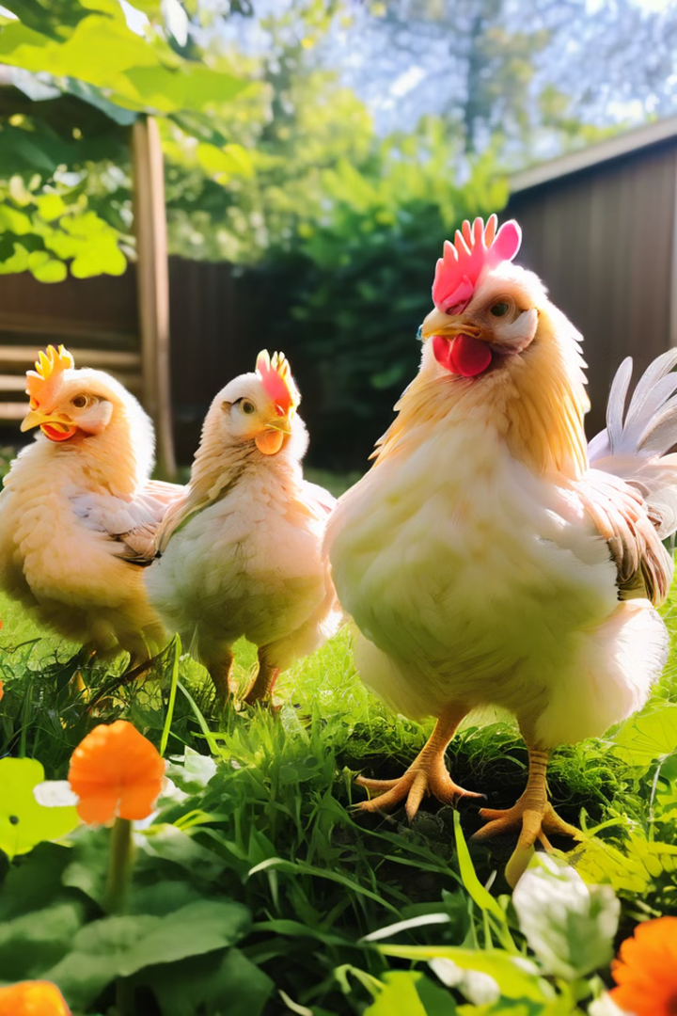


Emerging Issues in Backyard Organic Poultry Farming
Exploring the challenges and solutions for sustainable backyard organic poultry farming practices. Presented by Judith Akinyi Atela, judithatela@gmail.com, on August 12, 2024.
by Judith Akinyi

Slide 2
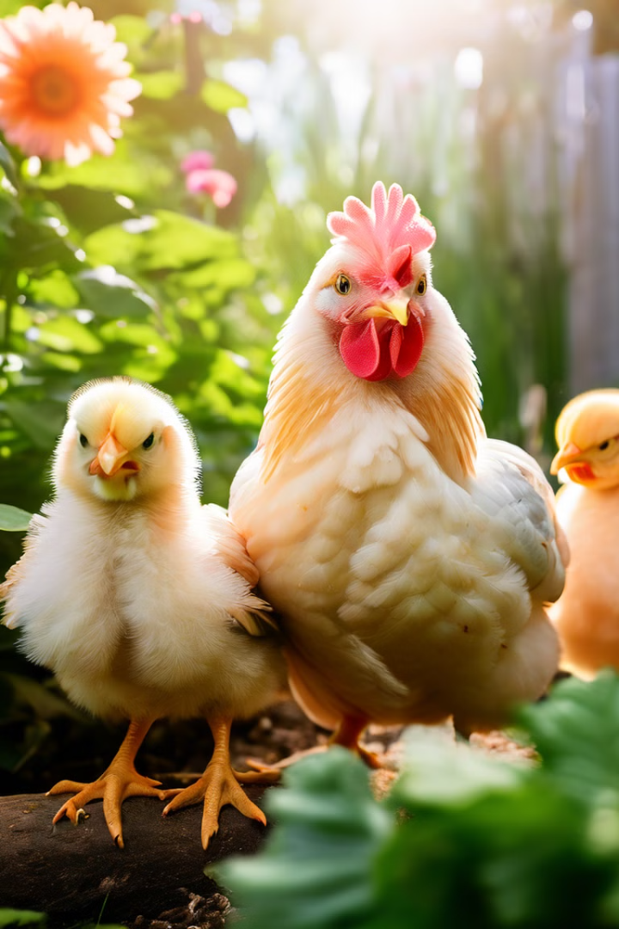
Introduction to Backyard Organic Poultry Farming
Backyard organic poultry farming is a sustainable practice that allows individuals to produce fresh, locally-sourced eggs and meat. It plays a crucial role in promoting food security and reducing the environmental impact of industrial-scale poultry production.

Slide 3
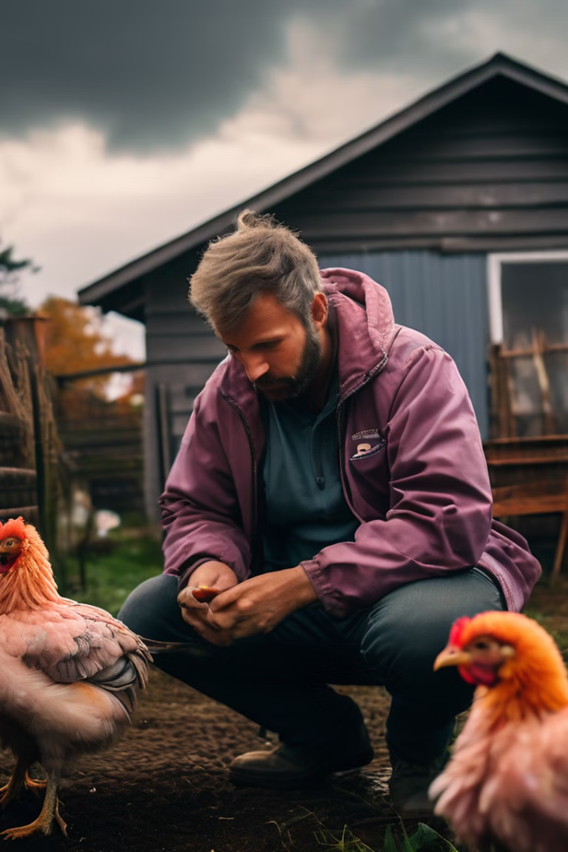
Emerging Challenges in Backyard Organic Poultry Farming
Backyard organic poultry farmers are facing growing concerns, including disease outbreaks, stricter regulatory requirements, and increasing market competition from larger commercial producers. These issues threaten the sustainability and viability of small-scale organic poultry operations.

Slide 4
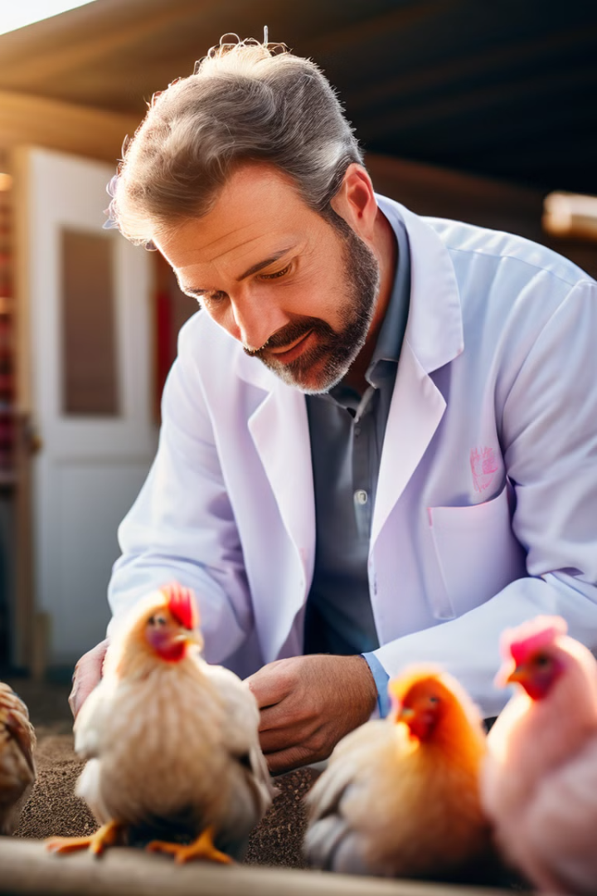
Combating Poultry Diseases
1
Disease Monitoring
Implementing regular health checks and surveillance to detect and respond to disease outbreaks early.
2
Biosecurity Measures
Adopting biosecurity practices, such as quarantine protocols and disinfection procedures, to prevent the spread of diseases.
3
Affordable Veterinary Care
Improving access to affordable veterinary services and community-based training programs for disease management.

Slide 5
Navigating Regulatory Compliance
Stricter Regulations
Compliance Costs
Simplified Processes
New organic certification and animal welfare regulations pose challenges for small-scale farmers.
The financial burden of meeting compliance requirements can be a significant barrier for backyard poultry farmers.
Collaboration with local authorities to streamline regulatory processes and provide support for small-scale farmers.

Slide 6

Addressing Market Access and Competition
1
Limited Market Reach
Difficulty in accessing local markets and competing with larger, commercial poultry producers.
2
Organic Certification
Challenges in maintaining organic certification and differentiating products in the market.
3
Cooperative Networking
Formation of farmer cooperatives to enhance market access and bargaining power.
4
Direct Sales Channels
Development of direct-to-consumer sales channels, such as farmers' markets and online platforms.

Slide 7

Strengthening Disease Management
Biosecurity Protocols
Implementing comprehensive biosecurity measures to prevent the spread of poultry diseases.
Community-based Training
Providing accessible training programs for backyard farmers on disease identification and management.
Affordable Veterinary Care
Improving access to affordable veterinary services to support small-scale poultry farmers.

Slide 8




Navigating Regulatory Compliance
Engaging with Authorities
Collaborating with local government agencies to advocate for simplified regulatory processes.
Subsidies and Support
Securing financial assistance and training programs to help small-scale farmers meet compliance requirements.
Streamlined Certification
Streamlining organic certification procedures to reduce the administrative burden on backyard poultry farmers.

Slide 9




Strengthening Market Access
Cooperative Networks
Forming farmer cooperatives to improve market access and bargaining power.
Direct-to-Consumer Sales
Developing online platforms and farmers' markets to connect directly with customers.
Organic Branding
Strengthening organic certification and product differentiation to compete with larger producers.

